Slide 1

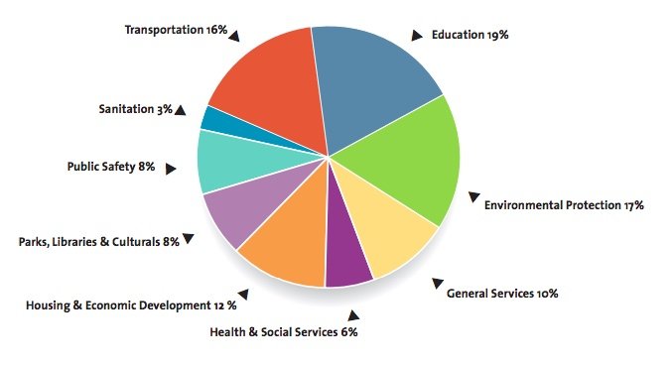
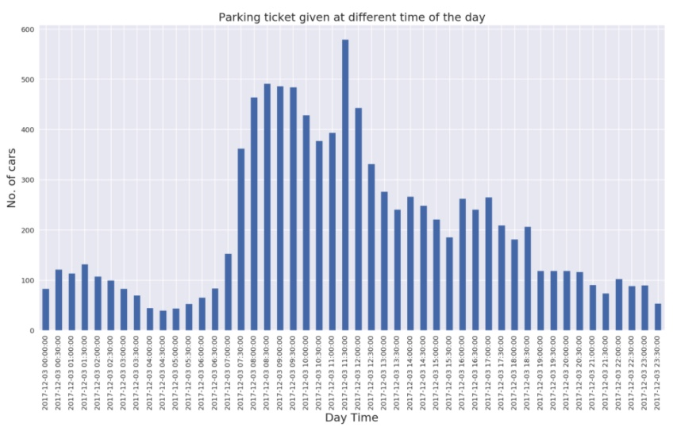
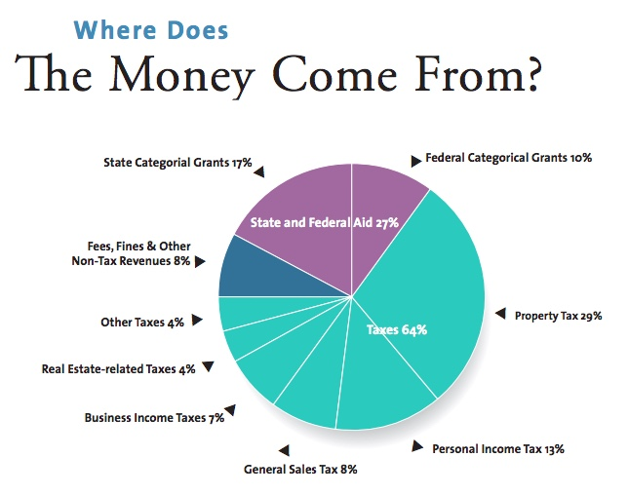
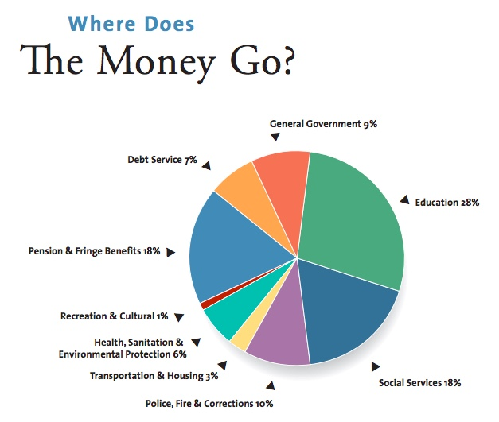
Analysis on NYC illegal Revenue
Abul Hasan Fazulullah , Siddharth Selvam
Department of Computer Science and Engineering
University of Bridgeport, Bridgeport, CT
Abstract –
New York City has always been the framed picture in terms of quality and wealthy lifestyle. Though being the small state in United States, the Cost of living still ranks third most expensive state. Comparing to Connecticut, New York is 65% more
expensive. Forty out of Fifty people would love to settle themselves in the city of New York irrespective of the expenses. But they have no idea about the real living in New York, in fact, the people who already live in NYC have very few idea about expenses in NYC. Also, NYC has a top-notch finance department for themselves and they know how to make money to run the city. To be specific, they know how to make miscellaneous money out of people to run the city. We have thoroughly worked on variety of datasets from Department of Finance and various open
information that is available to public. After our Research work, we could attain at a point that NYC is making approximately $860M a year with Parking Violation.
According to the New York budget guide, The rough revenue of NYC is $85B a year and it goes up exponentially every two years. The same report says that the expense would hit approximately $85B a year but the Mayor’s Management Report(MMR) which is released from Mayor’s Office of Operations twice a year has the actual expense reports which accounts more than $85B, coming to a conclusion for our findings that NYC is making unaccounted extra revenue out of the files. The first document that is released by the Mayor is known as Preliminary Mayor’s Management report. This report gives an approximate expense that is about to be spent for that particular year. Later that year, another report is published which is a refined version of the first report. This report will have the updated expenses that the city has to make in the remaining months of the year. Usually the Preliminary MMR is released in the second month of an year. i.e. February. This issuance of the reports is taken care by the acting director after collaborating with 45 city agencies and organizations. Figure 3 gives an information from the Fiscal year 2016 to Fiscal Year 2018 and how the expenses change between the Preliminary MMR and the MMR.
ENVIRONMENT SETUP –
For our project, we created an environment with total of 60 Gigabytes storage space and 16 Gigabytes of memory. This configuration is decent enough to process a very large dataset and process a query at a decent total time. To avoid the latency time, we enabled the password less SSH which is easy for the nodes to establish the communication.
MODELLING THE SYSTEM –
MAPPER FUNCTION –
MapReduce provides an effective environment to attain automatic parallelism. The MapReduce runtime system handles these internal low-level details to attain parallelism. This ease of use feature of MapReduce framework enables us to focus more on the application logic rather than dealing with low-level parallelization details. In our MapReduce framework, we are only concerned with expressing our problem or computation in a functional programming model. Once these functions are defined, the runtime system takes the responsibility of automatically parallelizing it on the given hardware architecture. Apache Organization suggests 82,000 maps for an input dataset with 10TB in size and 128MB block size. Also, the optimum level of parallelism for maps lies between 10 and 100. Thus number of maps that we used for this project is 11.
REDUCER FUNCTION –
Reducer includes three primary phases: Shuffle, Sort and Reduce. We use the following method to perform the reducing operation, reduce(WritableComparable, Iterator, Output Collector, Reporter). The output is written in the File system using Output Collector . collect ( Writable Comparable, Writable). The right number of reduces seems to be 0.95 or 1.75 multiplied by (<no. of nodes > * mapred . tasktracker . reduce . tasks . maximum).
Introduction –
Every one of us would love to have a better lifestyle than what we actually have now, no matter which point they stand at the moment. There are few couple factors which demonstrates the life of any individual. These factors includes Time, Money, health and etcetera. In that way money plays an important role as a building block in building their own life. In United States, to have a better life, people move towards the state with high quality of lifestyle. Of which, New York being the small state stands third in terms of cost of living. We started off with this project to find an answer for how New York makes money to run the city though being the small and densely populated city. Since we deal with the economic healthiness of that state, we started our research with overviewing the open information about New York and most specifically the information from the Department of Finance of NYC. Figure 1 represents the various income sources for New York City in the fiscal year 2017 while Figure 2 depicts the expenses that the state has to make in the Fiscal year 2017.
Figure 3
As you can see, the budget they publish is not as same as the expenses happened in that particular Fiscal Year. For example, the budget says, 19% for education but the actual expenses says, 28% for education. But this is not the issue, it can usually happen in any firm. To overcome this problem, Budget modifications occur year-round, with more emphasis placed on modifications associated with each quarterly Financial Plan. With this budget modification, the NYC is able to run that particular year. Also, The city’s constitutional debt limit, from the statement of debt affordability, is $90.2 billion in 2017 and $97.2 billion in 2018.So how does the NYC manage its revenue , they must have a way to tackle this.
Methods -
Our project deals with a variety of datasets with variable velocity and veracity. The two primary dataset that we used for this project is Parking Tickets Dataset and the dataset from the department of finance. The dataset includes the records from Fiscal year 2013 to Fiscal Year 2018 which comprises to approximately more than 8 Gigabytes of Textual Data. Being specific about the parking tickets dataset, it has approximately 54.6M+ Records and 44 Attributes (After processing the Dataset)(FY2013 to FY2018) and similar for the other set of datasets from Department of Finance. NYC openData repository is the major source of information for our project.
Talking about the parking tickets datasets, it is a realtime data which will automatically downloaded every last date of the month. We enabled a feature that can pull up information from the NYC OpenData repository and store in the local storage system in CSV file format which will then be easy for the data cleaning and processing.
DATA CLEANING -
This Data Cleaning includes removing unused attributes, replacing empty spaces with NULL, and make the attributes identical to the previous datasets. This Data Cleaning process also includes the Data Normalization. This normalization of data is usually done manually by checking across the other datasets. Once all these granular updates are done, the nuclear datasets are now combined into a single molecular dataset.
DATA PROCESSING -
Processing the dataset is one important operation that has to be performed before using them in the application. This process includes removing unnecessary data, version controlling and filling up the empty spaces and missing information.
GENERATING REALTIME DATA -
Generating real-time data is usually done using Web Crawling and by running a CRON Job at the desired repository. This both functionalities runs a periodic check on the database and look for any new information added. To reduce the complexity of this operation, the CRON job is also setup in a way that it checks only with the specified naming conventions which will narrow down the search operation.
ENVIRONMENT SETUP –
We used four separate machines to work on this project. Since we rely on Hadoop File System, We need one Namenode which takes care of all other nodes. We had a setup of three Datanodes. These nodes run Linux Operating System for themselves are can communicate with each other using Secure Shell(SSH). This secure shell enables these nodes to easily distribute the data across them without any intervention from the public traffic
SPARK FUNCTION –
We use the core Spark APIs to operate on the data. We use the RDD API to process on the dataset. This API performs two different operations, Transformation and actions. We also use DataFrame API. Spark is being the next generation of Hadoop which can process on realtime dataset but Hadoop lacks in processing the realtime dataset instead it can only process on static dataset and moreover to a fixed size.
PIG LATIN –
We used Pig Latin to work on few operations because Hadoop can do only batch operations. To run a Pig script, we need to copy the files from local system to HDFS. If the dataset is in some repository, we can import the dataset into the system using the “wget” which copies the dataset from a location using a static link. Then we need to start up the grunt interactive shell using the command “pig -x mapreduce”.
GOOGLE BIGQUERY –
We used Google BigQuery to query on our datasets and do an analysis to find the way of approach for the project. For Example, We did a query to find the number of vehicles from each state that has been ticketed so that we were able to find the state that are being more concentrated on issuing the tickets. Google Bigquery allows to process millions of data in seconds. In our case, it took approximately 50 to 60 seconds to process each query. We used one query and that is the final query to be executed to calculate the revenue generated. This particular query compares the value and updates in the dataset.
Figure 1
Conclusion -
In our project we were able to find the total amount the government is making from the parking tickets and other such violations. From this value we were able to roughly calculate the illegal revenue the government makes out of people which we call it as a miscellaneous revenue or dark money. As per our calculation, the government is making approximately $993M in the year 2016 and it has been increased to $1.9B in the year 2017. Also, this number is expected to increase every Fiscal Year. Out of this amount, we were able to find that $17M that is being collected from parking tickets are illegal. Extending more on this research would give the exact numbers but the numbers we mentioned are approximately close to the right value.
Figure 2
CPSC 651 – Big Data and Data Analytics

